Slide 1
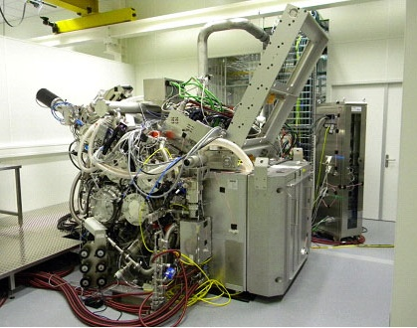
Lecture 6
Chemical Engineering for Micro/Nano Fabrication
Let there be light

Slide 2
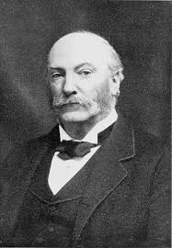
Rayleigh’s Rule…”k”
John William Strutt, third Baron Rayleigh
1842-1919
The Nobel Prize in Physics 1904

Slide 3
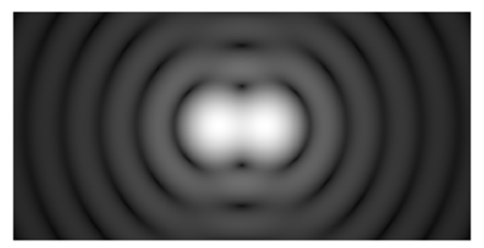
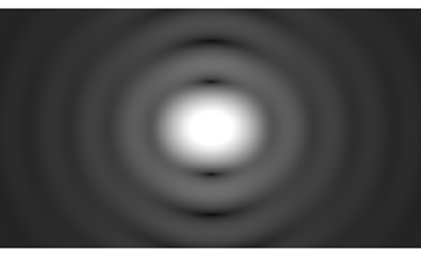
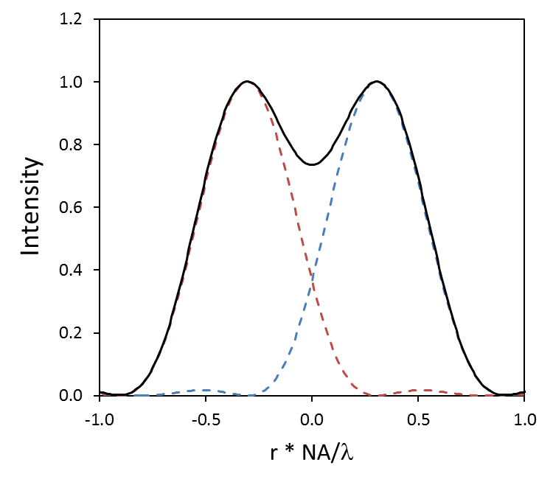
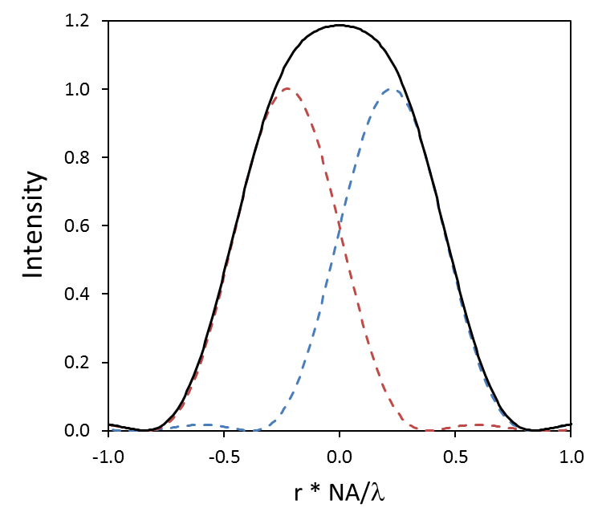


Rayleigh’s Rule for Resolution
Lord Rayleigh defined this criterion: when the first minimum of one Airy disk coincides with the maximum of another ->
$$0.6 λ/NA$$
$$0.6 λ/NA$$

Slide 4
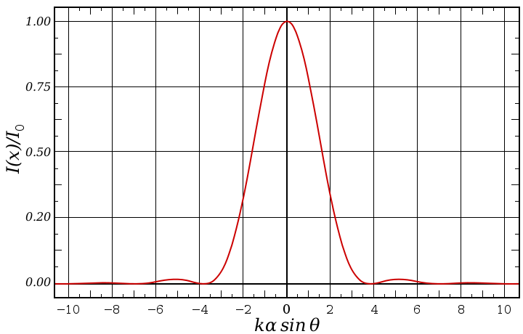
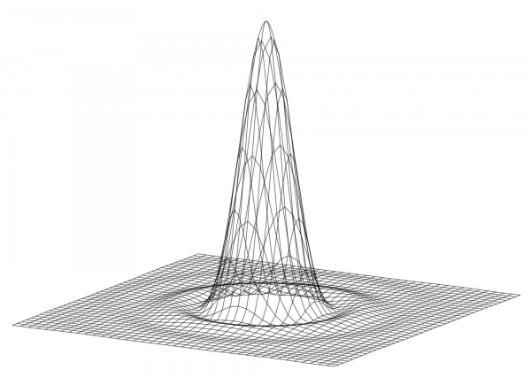
Defining the resolution of an imaging system
When a single point of light is imaged it becomes the point spread function (PSF) of the lens system.
  For an ideal, circular imaging system, the PSF is called the Airy disk:
  The FWHM of the Airy disk is 0.5 λ/NA, which defines the smallest image of a point source

Slide 5
Lithography breaks Rayleigh’s rule
Normal Incidence
Oblique Incidence
Mask
-1
0th
+1
-1
0th
Objective
Lens
sin θ_{max} = NA = λ/p_{min}
sin θ_{max} = 2NA = λ/p_{min}

Slide 6
We need a Next Generation Lithography
The “NGL”s

Slide 7


Next Generation Lithography - NGL
SEMATECH and the ITRS
  Beyond the 22 nm node
Optical Lithography | Electron Beam Litho.
High throughput Resolution limited EUV? | High Resolution Serial process Cross over Problem
$$R=k\frac{λ}{NA}$$
$$λ=\frac{h}{P}$$

Slide 8
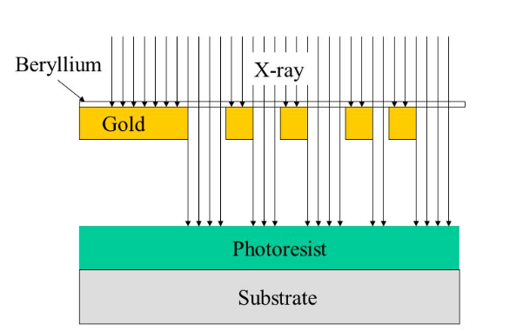
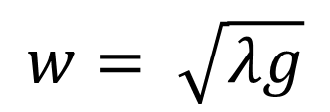

X-ray Proximity Printing
$$w= \sqrt{λg}$$
$$λ ≅1 nm$$

Slide 9
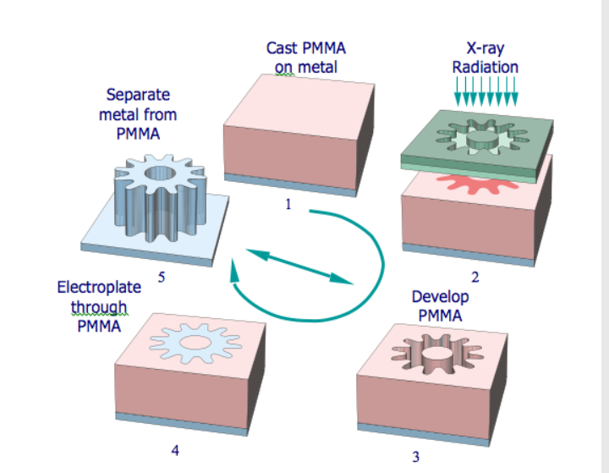
LIGA Process
LIGA is the german acronym for lithography, electroplating and moulding (Lithographie, Galvanik und Abformung).

Slide 10
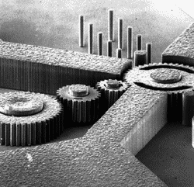
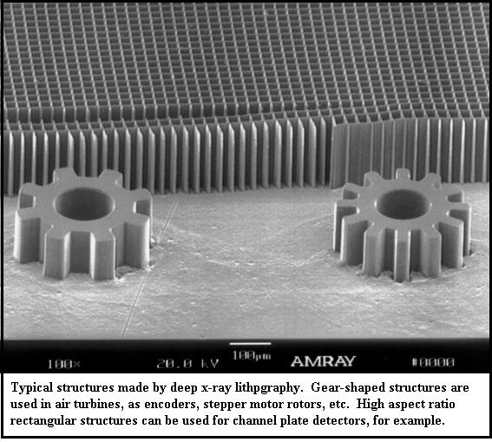
The LIGA Process and MEMS
Micro Electo Mechanical Systems

Slide 11
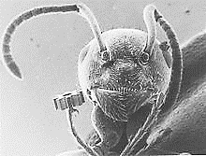
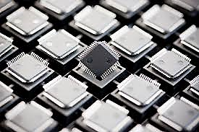
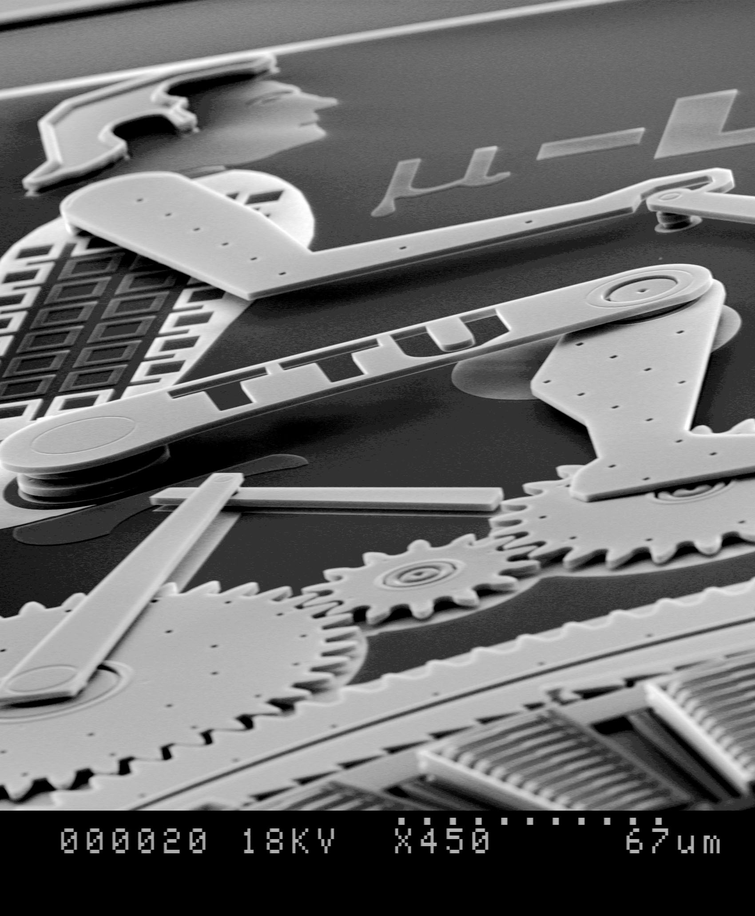
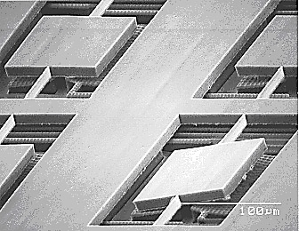
LIGA PROCESS

Slide 12
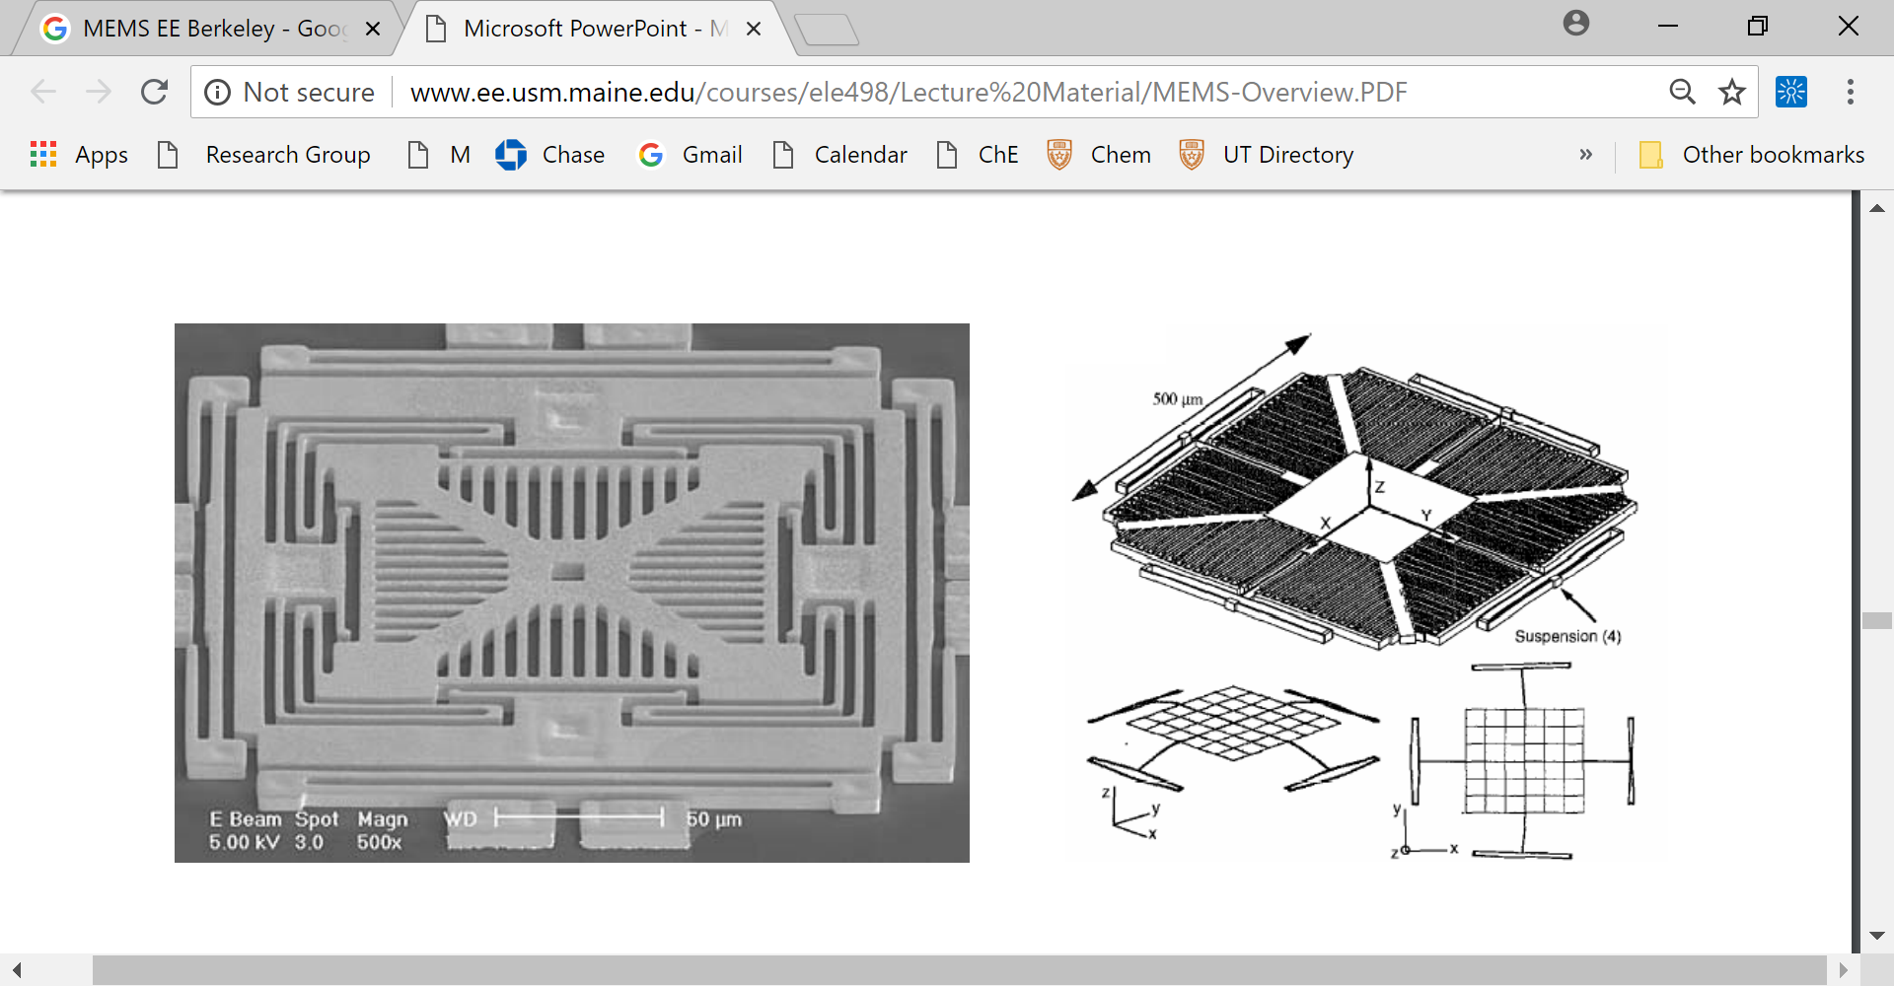
3 Axis Accelerometer EE-UC Berkeley

Slide 13
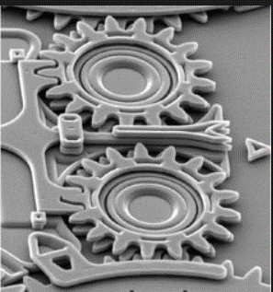
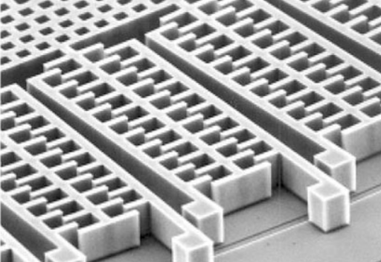

Slide 14
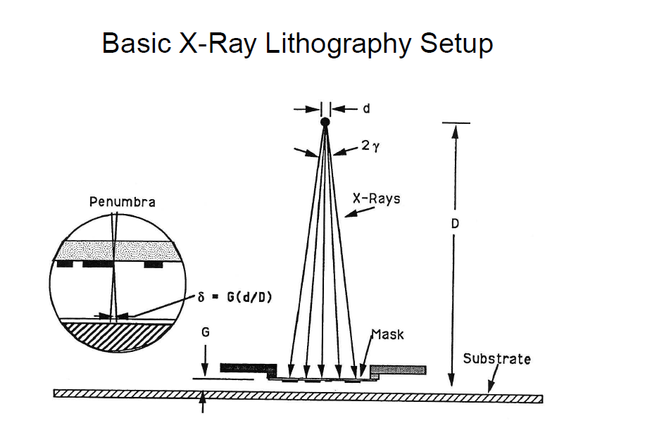

Slide 15
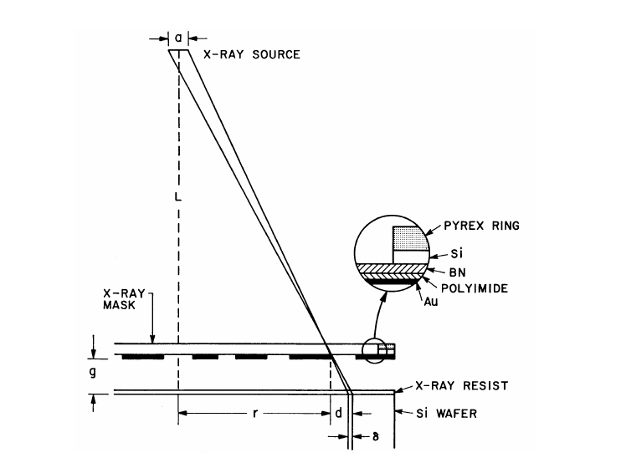
RUN OUT ERROR
Penumbral blur
δ = ag / L
Run out mag error
d = rg / L
Source needs to be very far away!
but intensity proportional to 1/L²

Slide 16
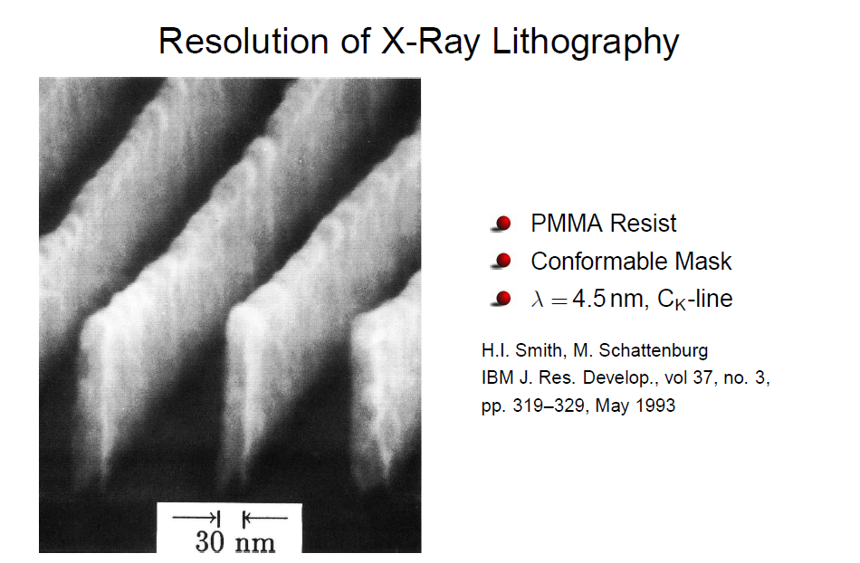

Slide 17
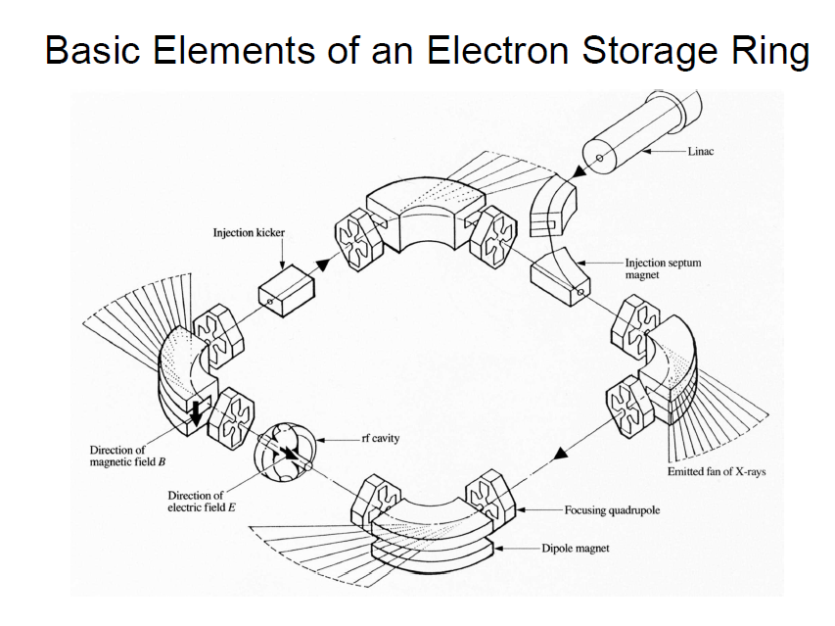

Slide 18
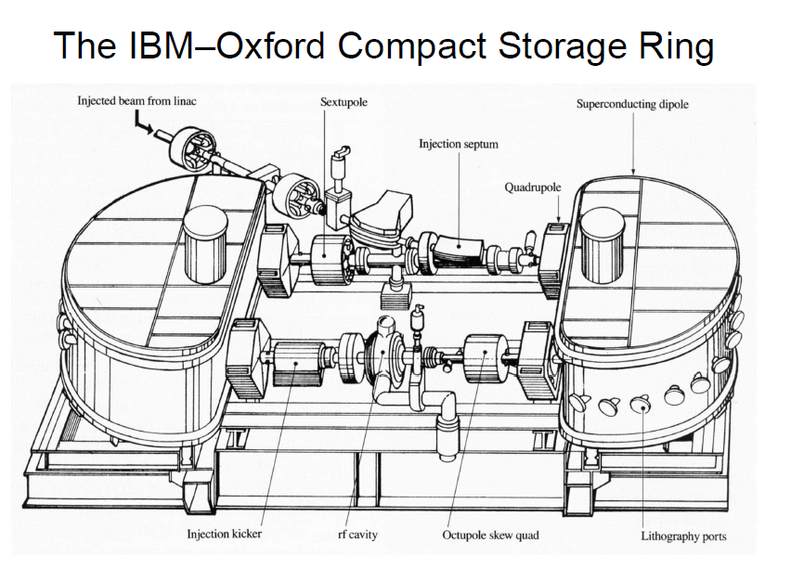

Slide 19
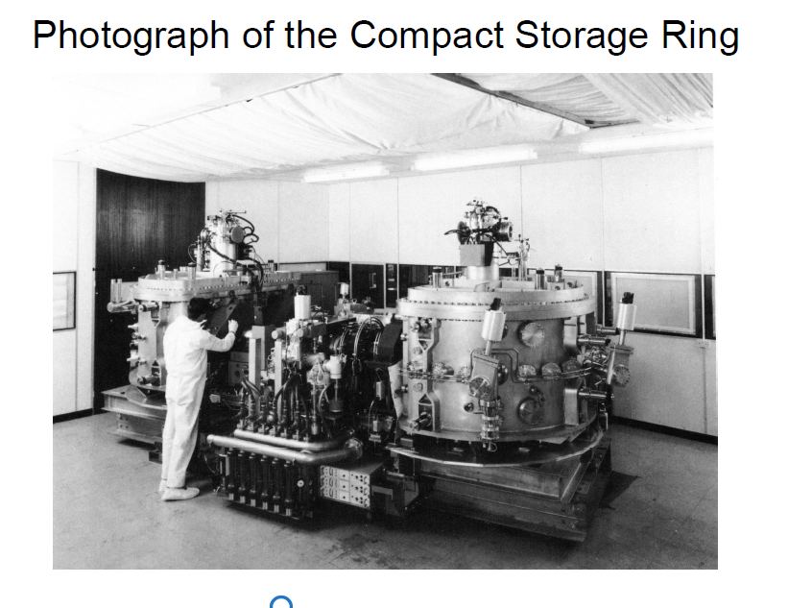

Slide 20
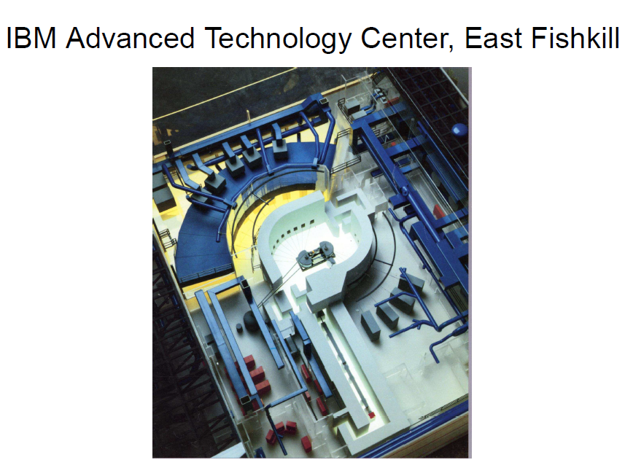

Slide 21
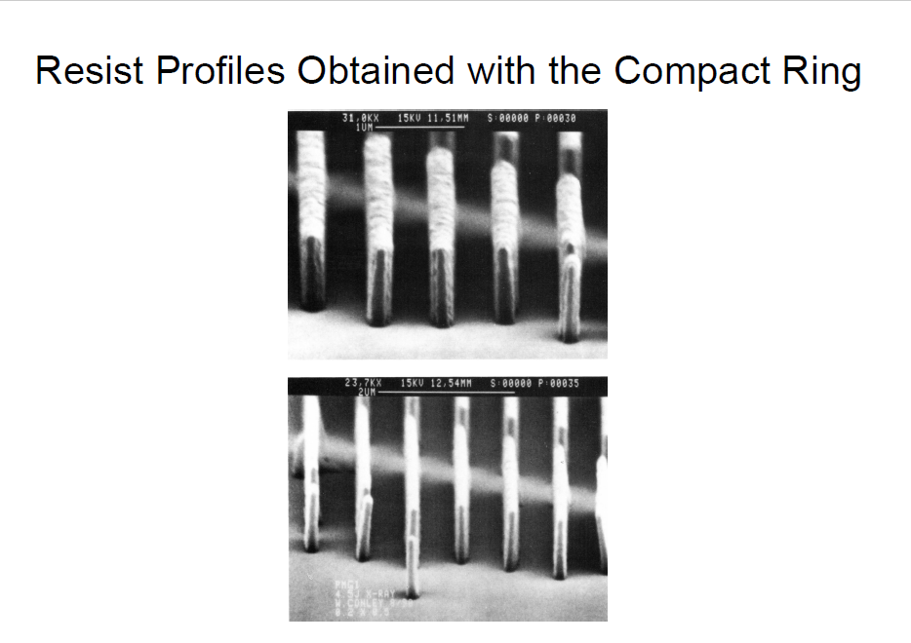

Slide 22
In the end….
Over lay and mask issues killed the x-ray program
  Distortion due to patterning
  Heating
  Optical transparency issues
Optics caught up and was cheaper, faster and safer.
  I-line steppers could out perform the x-ray system
LIGA led to MEMS which is alive and well

Slide 23
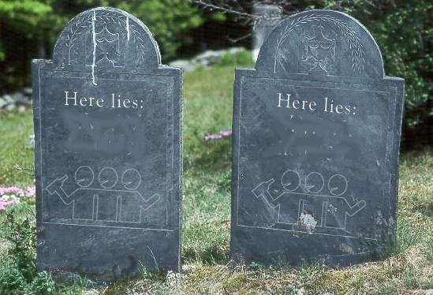
The Landscape is littered with NGL’s
Electron Beam direct write
Write with many electron beams
Project electron beams
157nm Photolithography
Shadow printing with Synchrotron X-rays
157nm
X-ray
X-ray
157nm

Slide 24
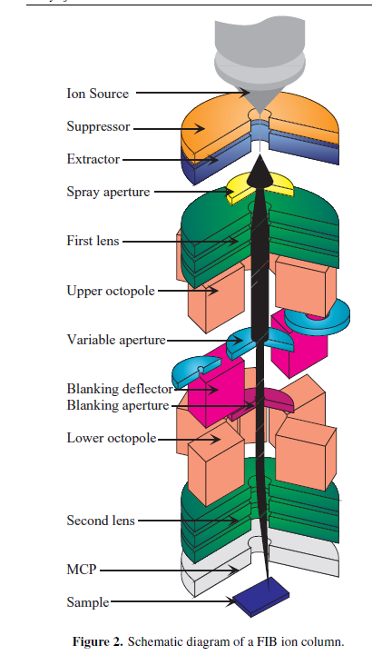
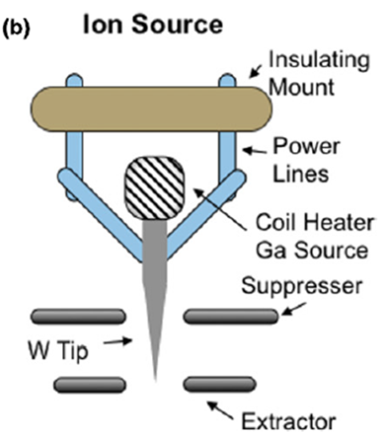
Focused ion beam lithography

Slide 25
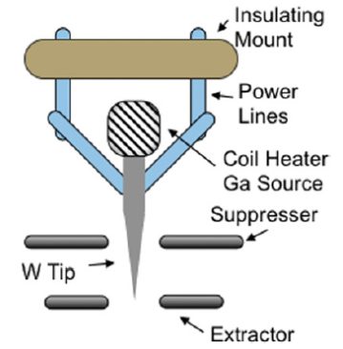
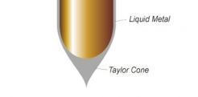
Liquid Metal Ion Source

Slide 26
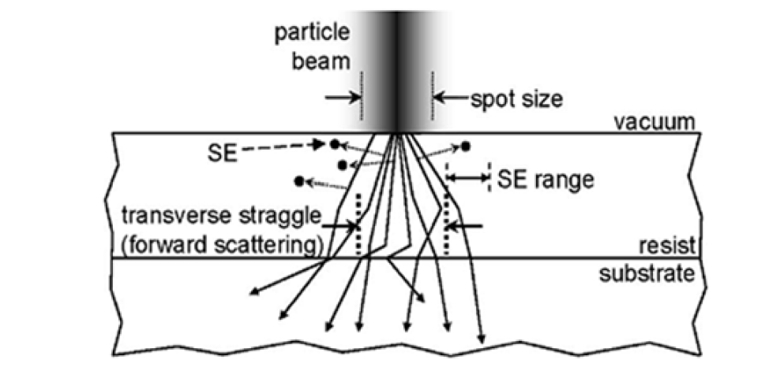
Inelastic (Electronic) Collisions
[6]
Conversion of KE to other forms of energy
  Required for ion induced chemical reaction
Negligible scattering of incident ion
Ionization of target atoms and SE generation
  SE play significant role in bond dissociation – resists

Slide 27
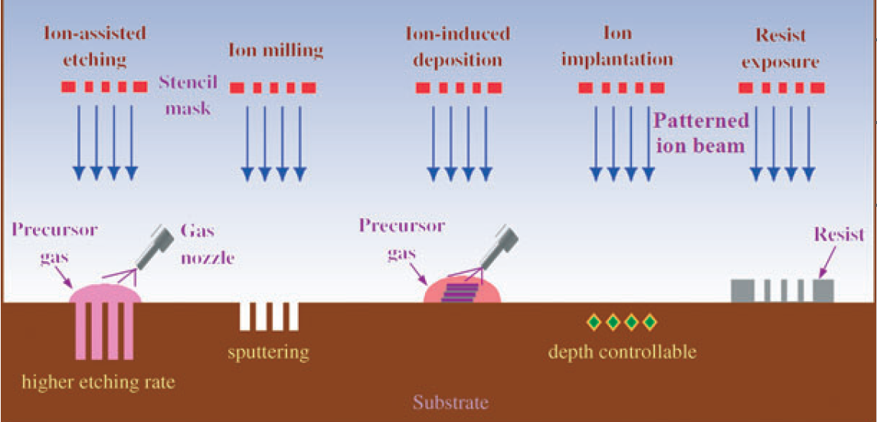
Motivation: Ions
[2]
Small particle wavelength -Not diffraction limited
Large Mass
  Less scatter – No proximity effects
  Delivery more energy than e⁻
Additional capabilities:

Slide 28
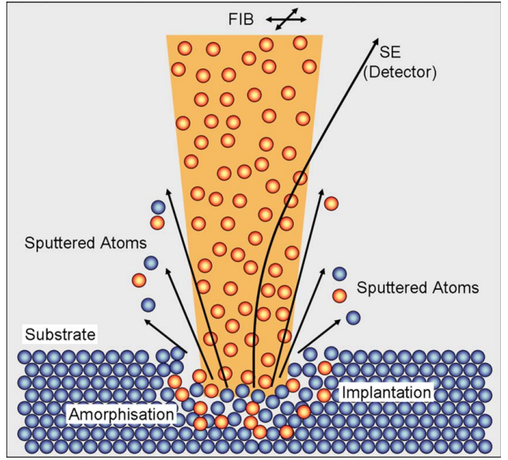
Physical Milling or Sputtering
Ability for resistless structuring
Elastic Cascade Model
Sputter or Milling Yield
  Target atom
  Ion species and energy
  Angle of incidence
  Orientation dependent
Slow – high dose req.

Slide 29
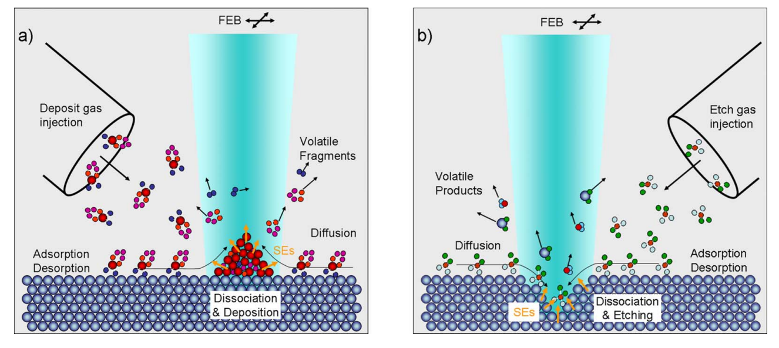
Gas Assisted Etching (GAE) and Deposition (GAD)

Slide 30
Resists for IBL
Secondary electron induced bond dissociation
Energy deposition dependent resist
  Low mass to energy ratio – electric stopping
  High mass to energy ratio – nuclear stopping
Positive tone resist becomes negative
  Crosslinking induced by radicals liberated by ions
  Pattern both pos./neg. by varying energy!

Slide 31
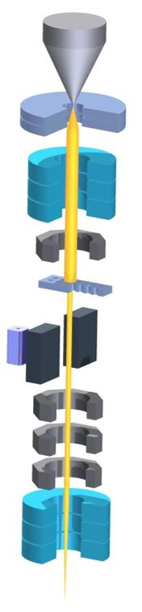
Ion Beam Properties
Energy spread leads to chromatic aberration (blur)
Space charge effects add to energy spread
Beam diameter proportional to beam energy
Ga⁺
Ga⁺

Slide 32
Ion Projection Lithography: Masks
Thin metal membrane (Si) with apertures
Control issues:
  Stress relief & thermal expansion
Overlay or “Donut Problem”
Target
Feature
A Mask
B Mask

Slide 33
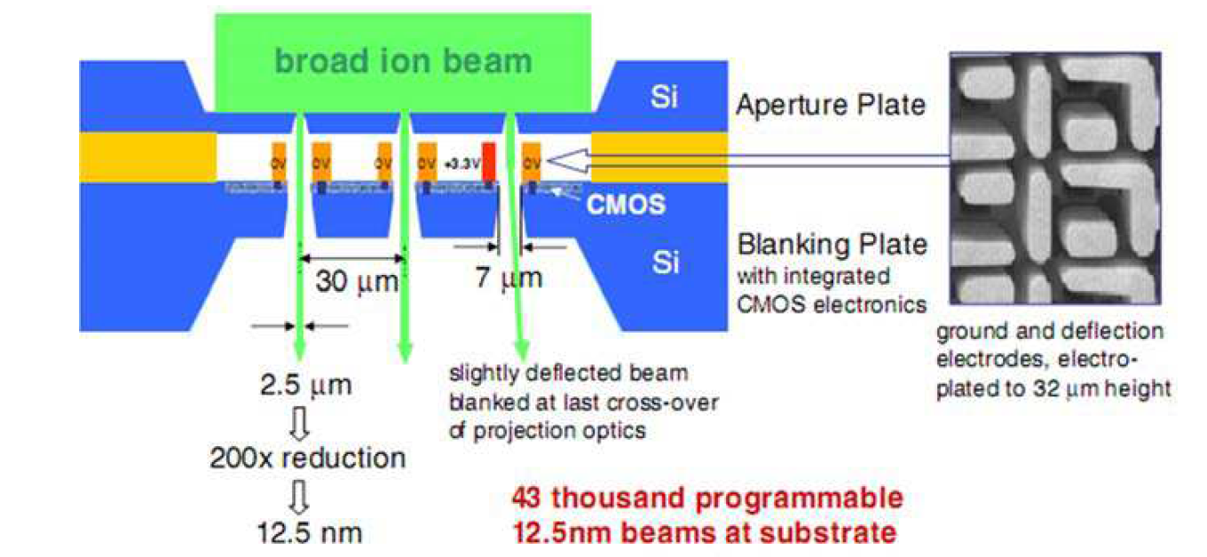
Future Outlook
[2]
Multibeam tool: 43-APS by IMS
  Gas discharge broad beam
  Programmable shutter aperture plate
  43,000 beams, demagnification 200x
  Ion dot matrix printing for NIL*

Slide 34
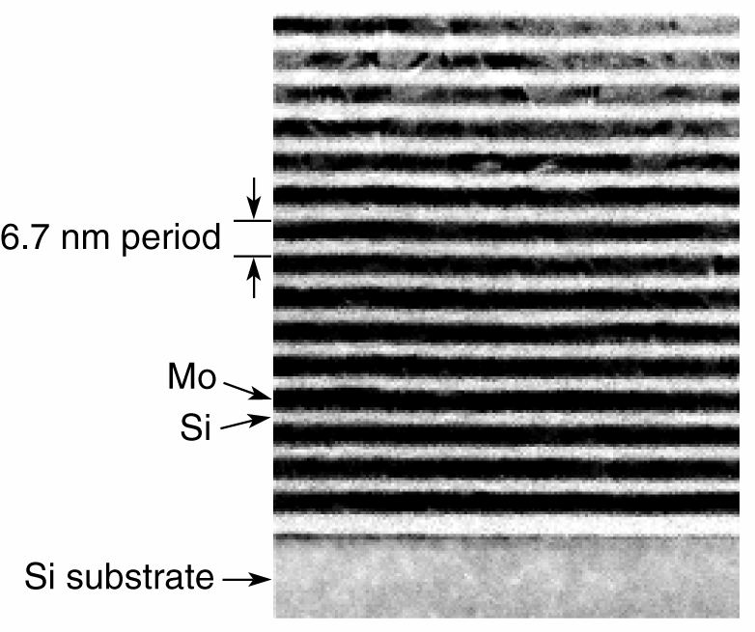
Fortunately, …..on the Horizon is….EUV
Film Stack
Reflectivity
X-ray Mirrors Created at LLNL and Sandia

Slide 35
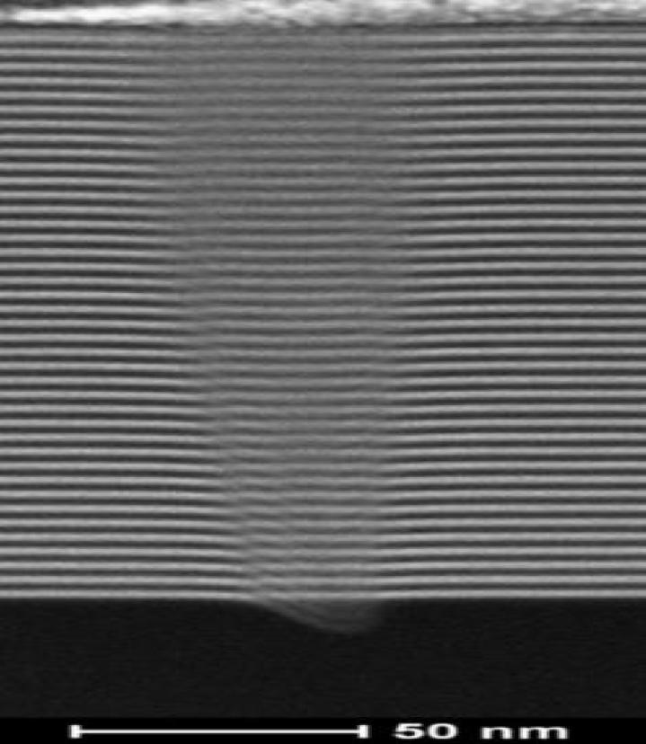
A “Phase Defect

Slide 36
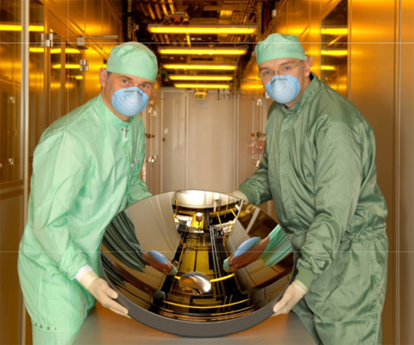
EUV Mirror

Slide 37
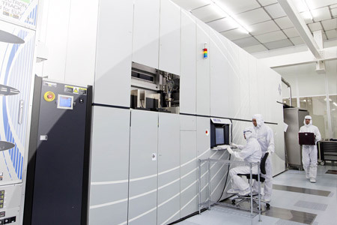
The path to success is 11nm EUV??

Slide 38
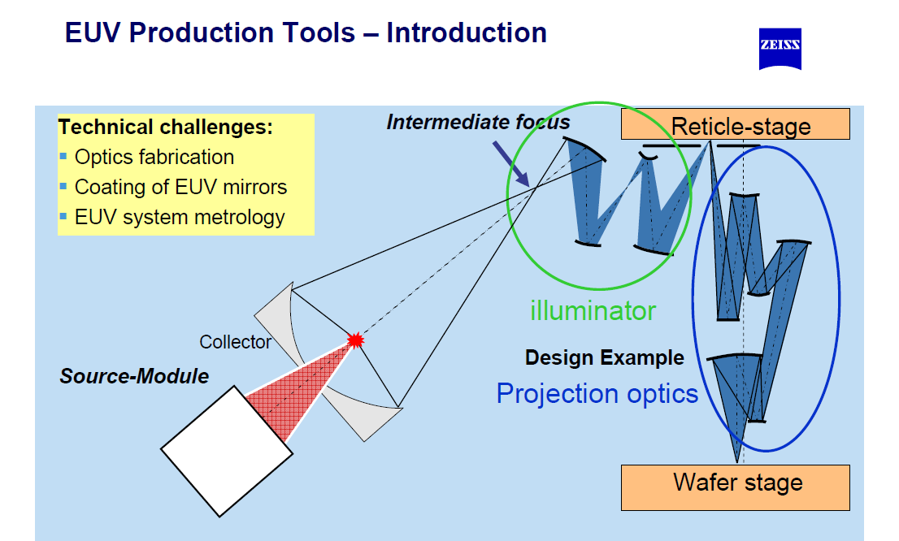

Slide 39
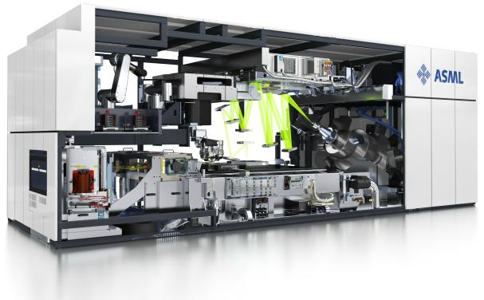
Large, complex, costly solution
0.6⁹ ≅ 0.00 ≅ P(success) !!

Slide 40
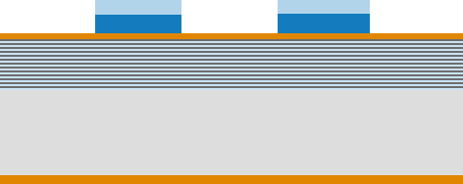
EUV Mask
Tantalum boron nitride
Silicon Dioxide
Ruthenium
Molybdenum Silicon Stack
Ultem Substrate
Chromium Nitride

Slide 41
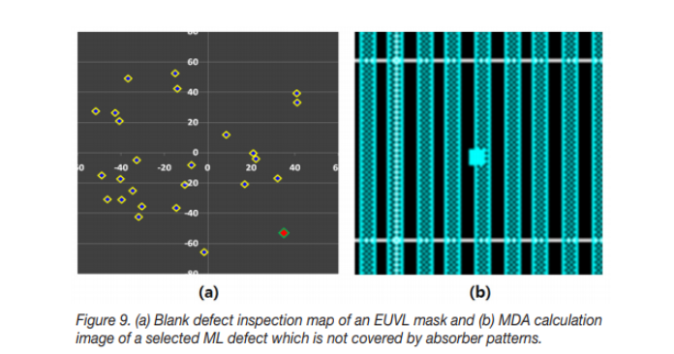
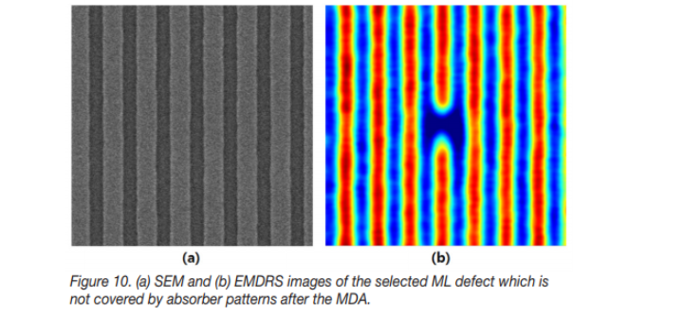
Living with Defects

Slide 42

Let there be light!
EUVL

Slide 43


Slide 44


Slide 45

This is just an EUV light bulb that is 100x to dim!!
Large, complex, costly solution

Slide 46

Cymer EUV Light Source

Slide 47


What is under the floor – out of sight

Slide 48

A Laser Bank

Slide 49

Source produces “out of band” radiation as well as EUV

